Slide 1
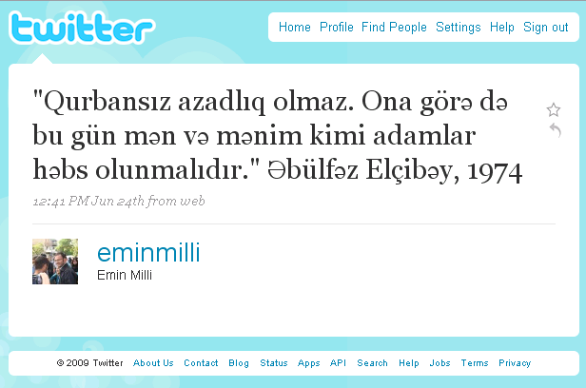
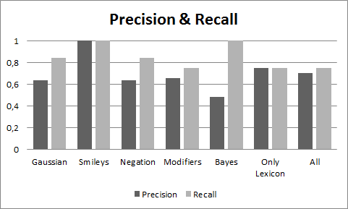
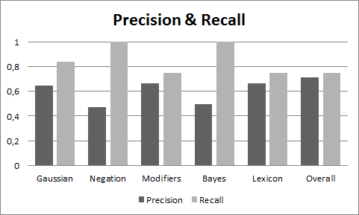
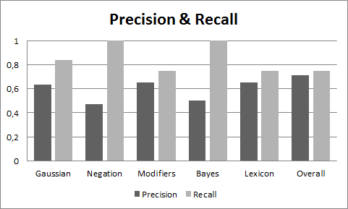
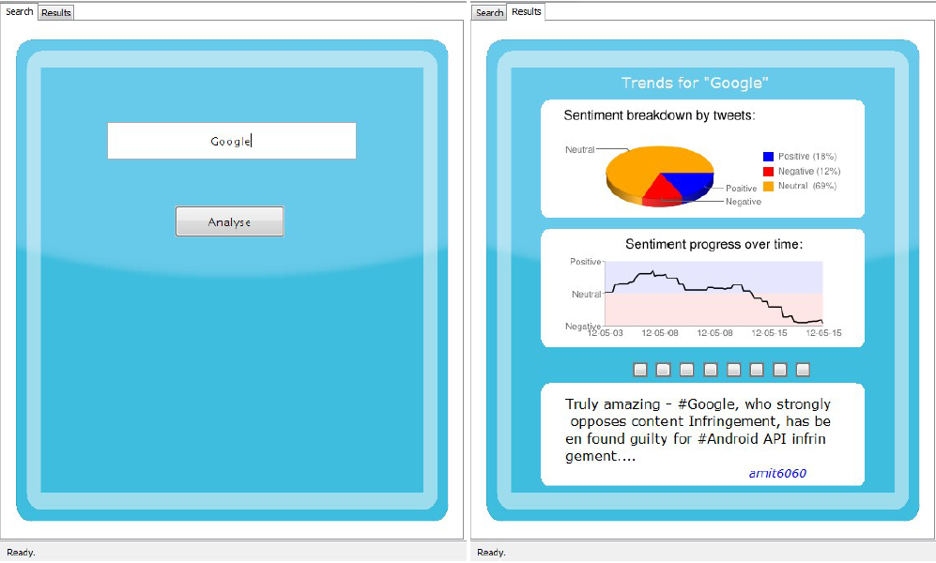
Reputation Management System
Mihai Damaschin Matthijs Dorst Maria Gerontini
Cihat Imamoglu
Caroline Queva
Problem
Jkhsflkjhsd
Zefz
Qsdf
asdf
Methods
Search
A
A
A
A
Qs
Qsdf
Zefz
df
Before :
Now :
Search
Naïve Bayes
I like this company, and you ?
Extract the tweet content
Transform it into a feature vector
Train the model with the extracted annotated data
Serialize the model
No I don’t, I think it’s not a good one.
I like this company, it’s a really good one. You should try ! It’s awesome !
Search for specific keywords : provided by Twitter
Problem : their in-memory solution is limited to the last 8 days
To handle this problem, store the search results in a MySQL database.
Query the database as well as the Twitter search.
Increase recall.
Use the algorithm provided by Weka and the hand-classified data provided by Sanders Analytics
Someone
It was difficult to track brand reputation.
It is possible to know brand reputation by monitoring social media.
Don’t use a relevance score based on term frequency
and document frequency, since tweets are limited in length.
PageRank
Use number of retweets, number of followers, friends and other tweets of the author
Use information about the maximum of such numbers
Use log of the features and a simple linear mixture
Obtain a single number representing authority
We worked on an online reputation management system that categorizes tweets as negative, neutral or positive and measures the reputation of a brand according to that.
Get tweets
Calculate a static quality measure
Retrieve data about the tweets : Use Twitter REST API.
I like this company, it’s really good.
Twitter API
Tweet text
Author
Number of followers
Number of retweets
…
Results
J
Zefz
Qsdf
qsdf
khsflkjhsd
Experimental Set up:
Use an existing twitter corpus, provided by Sanders Analytics
Split this data set for training and testing
10-folds cross validation
Measure precision and recall
Use the query “Microsoft” for testing.
Someone
Four different methods are used for the sentiment prediction :
Gaussian distance.
Detection of negations and modifiers.
Bayes classifier
Lexicon with assigned negative and positive scores.
Effect of the presence of smileys on the sentiment score.
Problem encountered : the rate limit imposed by the API (150 calls per hour, when not authenticated and 350 otherwise).
Solution found : caching.
Problem encountered : the rate limit imposed by the API is a problem for the creation of a user graph. Consequently, it was not possible to apply the original PageRank algorithm.
Preprocessing and Tokenization
User interface
Elimination of repeated characters
Goal : keep the design as simple and self explanatory as possible, while maintaining the essential functionality
Greeeaaaat Greeaat
Aweeesome Aweesome
Look Look
Search input
Annotations and URL’s removal
The user is presented with a single text input field and a single button. The only distracting elements are the status bar at the bottom (which provides real time information on the analysis progress) and tab bar, enabling a user to switch to previous search results
@Someone : it’s awesome. Check www.this.com.
: it’s awesome. Check.
Search results
A break-down of positive, negative and neutral tweets is displayed as pie chart; using the Google Charts API.
To provide time dependent information, a second graph is used to display the cumulative reputation over time.
Lastly, a list of top-ranked tweets is provided. By clicking on any of the square buttons, a top-sentiment tweet can be viewed.
Results for unfiltered data
Tokenization : Use StandardTokenizer from Lucene
Results for data without URL and annotations
Send to this@mail.com. This is perfect.
Tokenizer
Send
to
this@mail.com
This
is
perfect
Conclusions about the preprocessing step :
Using negations and modifiers result in a significant improvement in terms of recall.
The performance in terms of precision is decreased.
The Bayes classifier does not provide any improvement.
The overall score is improved when using the filtered data.
Sentiment analysis
Lexicon : find the score of a tweet to label it as negative, neutral or positive.
Standard lexicon
“It is good” => score = 0+0+1 = 1
Modifiers and negations : add a coefficient for the following words
“It is not good” => score = 0+0+0+(-1)*1 = -1
Distance : the score decreases as the distance between the sentiment word and the name of the company increases
“I like A but I really hate B” => Positive score for A, negative score for B
Results for data without repeated characters

